Slide 1
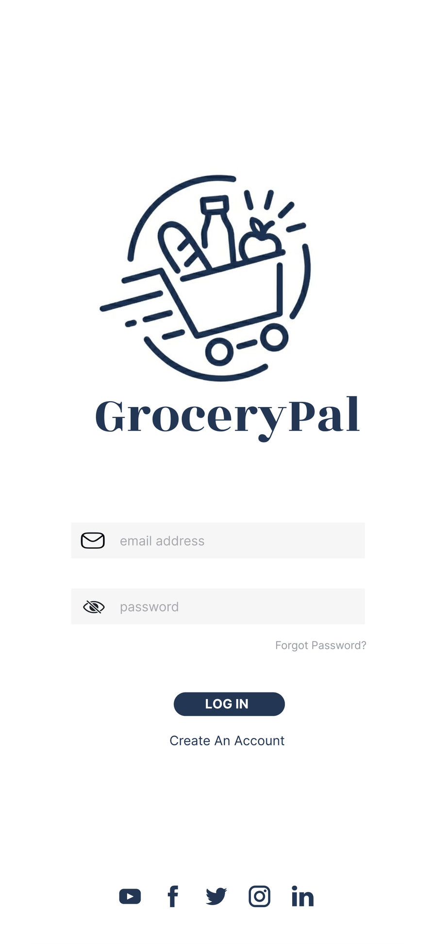
GroceryPal: Helping Students Shop Smarter
Team 5 — Alejandro De La Torre, Angelique Carrillo, Helena Huang, Peixin Yang, Yanbin Chen, LIS 470 · Spring 2026
Notes:
Alejandro (~25 sec):
Hi everyone — we’re Team 5, and we’re here to introduce GroceryPal: a mobile app that helps college students plan grocery trips that actually fit their budget. I’m Alejandro, joining me are Angelique, Helena, Peixin, and Yanbin. Over the next seven minutes we’ll show you how our understanding of this problem changed across the semester, and how that evolution shaped the design you’ll see at the end.

Slide 2
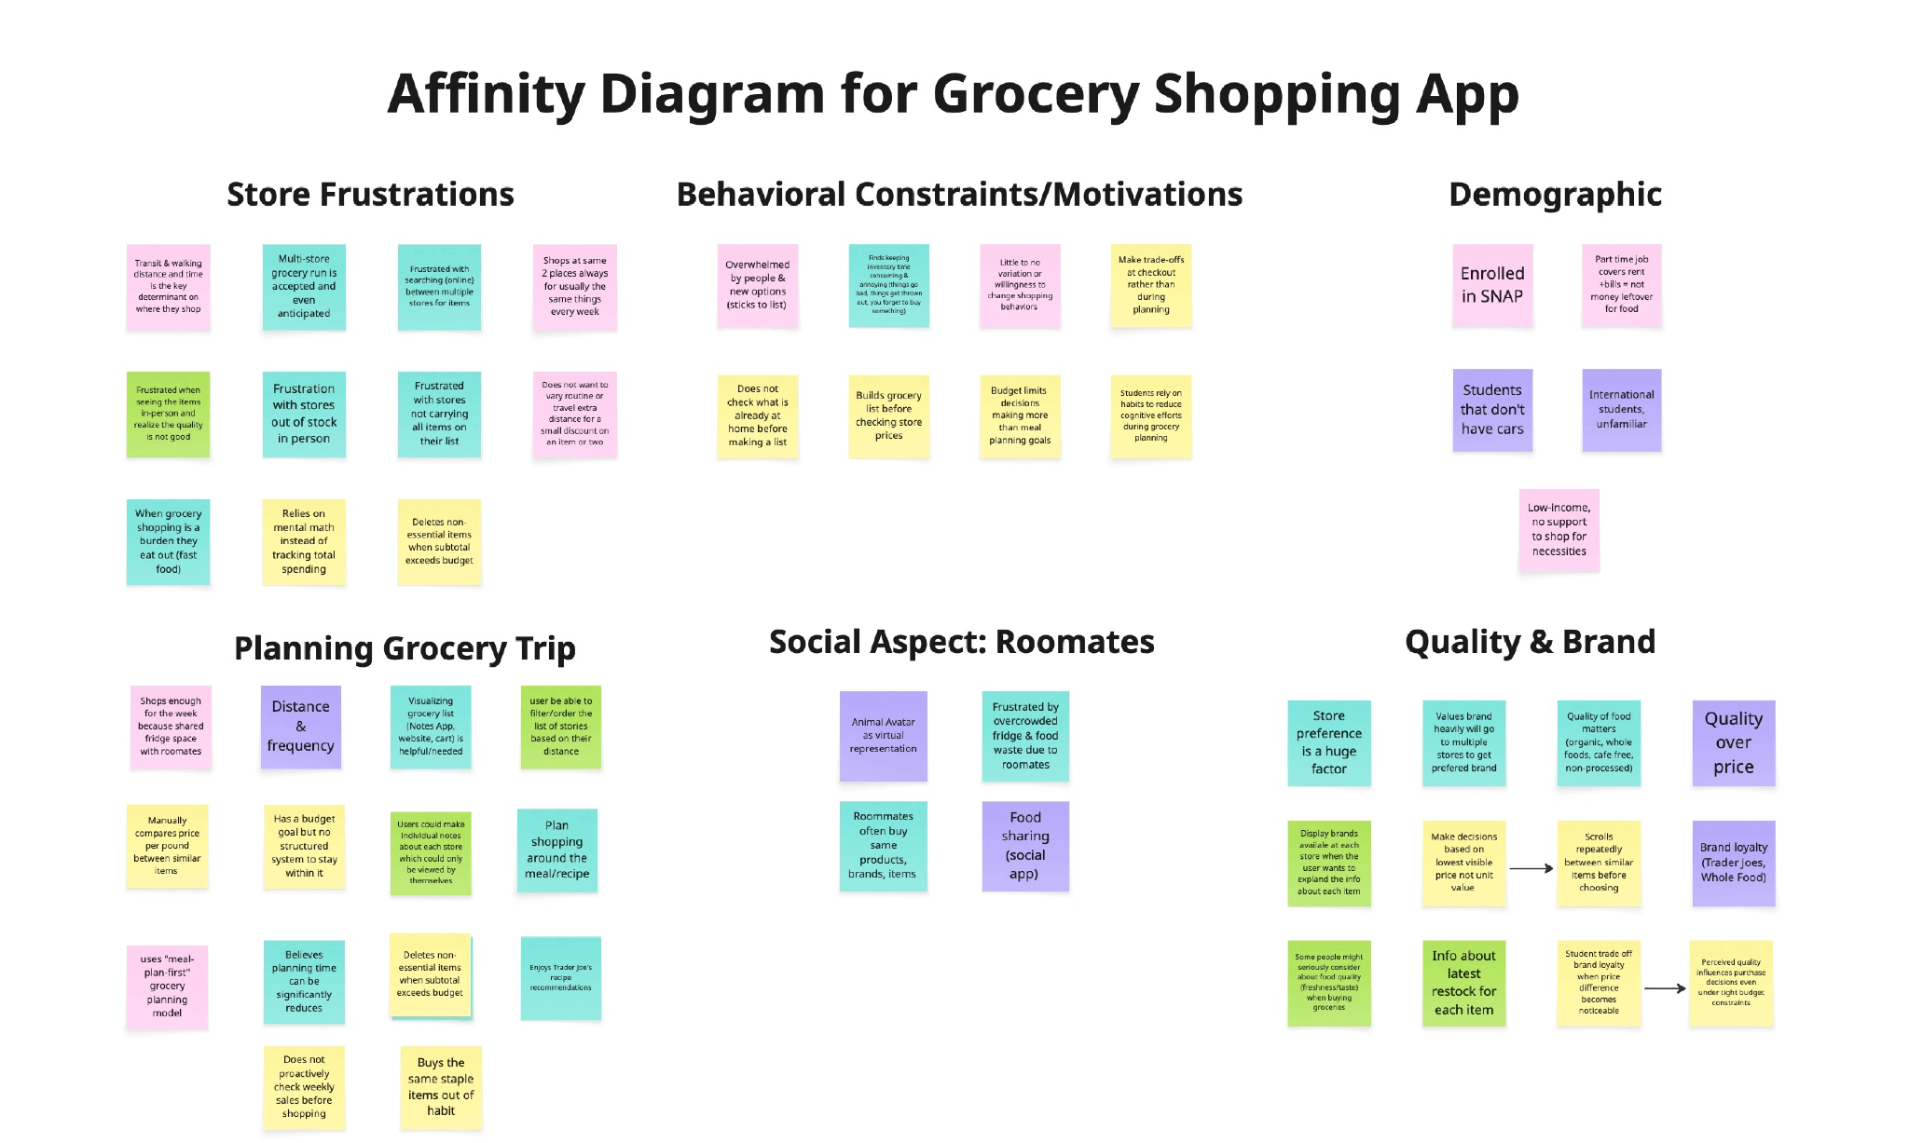
Four Activities, One Trip
Students aren't just shopping. They're budgeting, planning transit, coordinating with roommates, and managing decision fatigue — all at once. One participant routed herself between two stores on foot specifically because the inconvenience kept her from impulse buying.
Notes:
Peixin (~60 sec): Our project started with contextual inquiry. The five of us shadowed UW–Madison students through their actual grocery routines — at Kwik Trip, Trader Joe’s, Capital Centre Market, and online through the Target app. We sat with them as they checked their pantries, built lists on their phones, and made stop-by-stop decisions in the aisles. From these observations we learned something we didn’t expect: grocery shopping for students isn’t really one activity — it’s at least four, layered together. They’re simultaneously budgeting, planning transit, coordinating with roommates over text, and managing decision fatigue inside the store itself. One participant even routed herself between two stores on foot, deliberately, because the inconvenience kept her from impulse buying. That layering is what made the design challenge real — and it’s where every later decision started.

Slide 3
Six Themes, Three We Built Around
Behavioral Routines
Coordination Overhead
Store Frustrations
Routine reduces stress more than deal-hunting. Students pick the same stores and brands every week to lower the cognitive cost.
Duplicate buys and food waste happen when roommates can't see each other's lists. The breakdown is communication, not effort.
Students already route between stores for the cheapest split. We don't need to teach this — we need to absorb it.
Notes:
Angelique (~60 sec): After our field work we built an affinity diagram together — clustering every observation into themes. Six themes surfaced: store frustrations, behavioral routines, demographic constraints like SNAP and transit, planning behaviors, the social context of roommates, and quality and brand preferences. Of those six, three patterns mattered most for the design we’d eventually build. The first surprised us: students don’t actually deal-hunt — they build routines. They pick the same stores, brands, and days, because routine reduces cognitive load even more than chasing the cheapest price does. The second was that roommates create hidden coordination overhead — duplicate purchases and food waste happen when communication breaks down. The third was that price comparison and store-routing isn’t optional — students are already doing this work in their heads, every week. From the affinity diagram we learned that our design’s job wasn’t to add features. It was to absorb the mental work students were already doing.

Slide 4
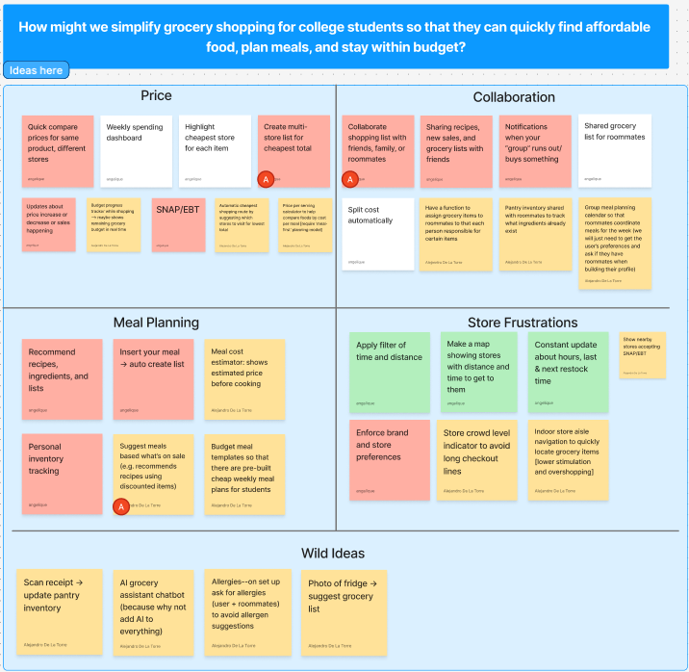
The Problem
Point of View
Budget-constrained students need simple ways to plan efficient grocery trips without increasing cognitive effort or time.
Notes:
Helena (~50 sec): Those insights gave us a single point-of-view statement: budget-constrained students need simple ways to plan efficient grocery trips without increasing cognitive effort or time. The tension in that sentence is what made it useful. Students want thoughtful, cost-conscious decisions — but the process of getting there is exhausting. So our problem wasn’t ‘help students save money.’ It was ‘help students save money without asking them to think harder.’ Every later design choice — from how we showed prices to how we labeled the bottom navigation — got tested against this lens: does it reduce mental effort, or does it just hide the effort somewhere new?

Slide 5

Three Concepts, One Product
Peer critique pushed us to combine, not pick.
Price comparison needed roommate sharing.
Meal planning needed pantry awareness.
Collaboration needed budget tracking.
They weren't competing — they were three angles on the same problem.
Notes:
Yanbin (~70 sec): With our problem framed, we ran a brainstorming session around a How-Might-We prompt: how might we simplify grocery shopping so students can quickly find affordable food, plan meals, and stay within budget. We generated dozens of ideas and grouped them into four themes — Price, Collaboration, Meal Planning, and Store Frustrations — then dot-voted three concepts worth developing further: a price-comparison tool, collaborative roommate lists, and a meal-planning assistant. Here’s where the project pivoted. When we each sketched one concept and ran a peer critique, we kept telling each other to combine features rather than pick one. The price tool needed roommate sharing; the meal planner needed pantry awareness; the collaboration tool needed budget tracking. So we made a deliberate choice: rather than picking one, we’d build the integrated version. From brainstorming and sketching we learned that the three concepts weren’t competing — they were three angles on the same underlying problem.

Slide 6
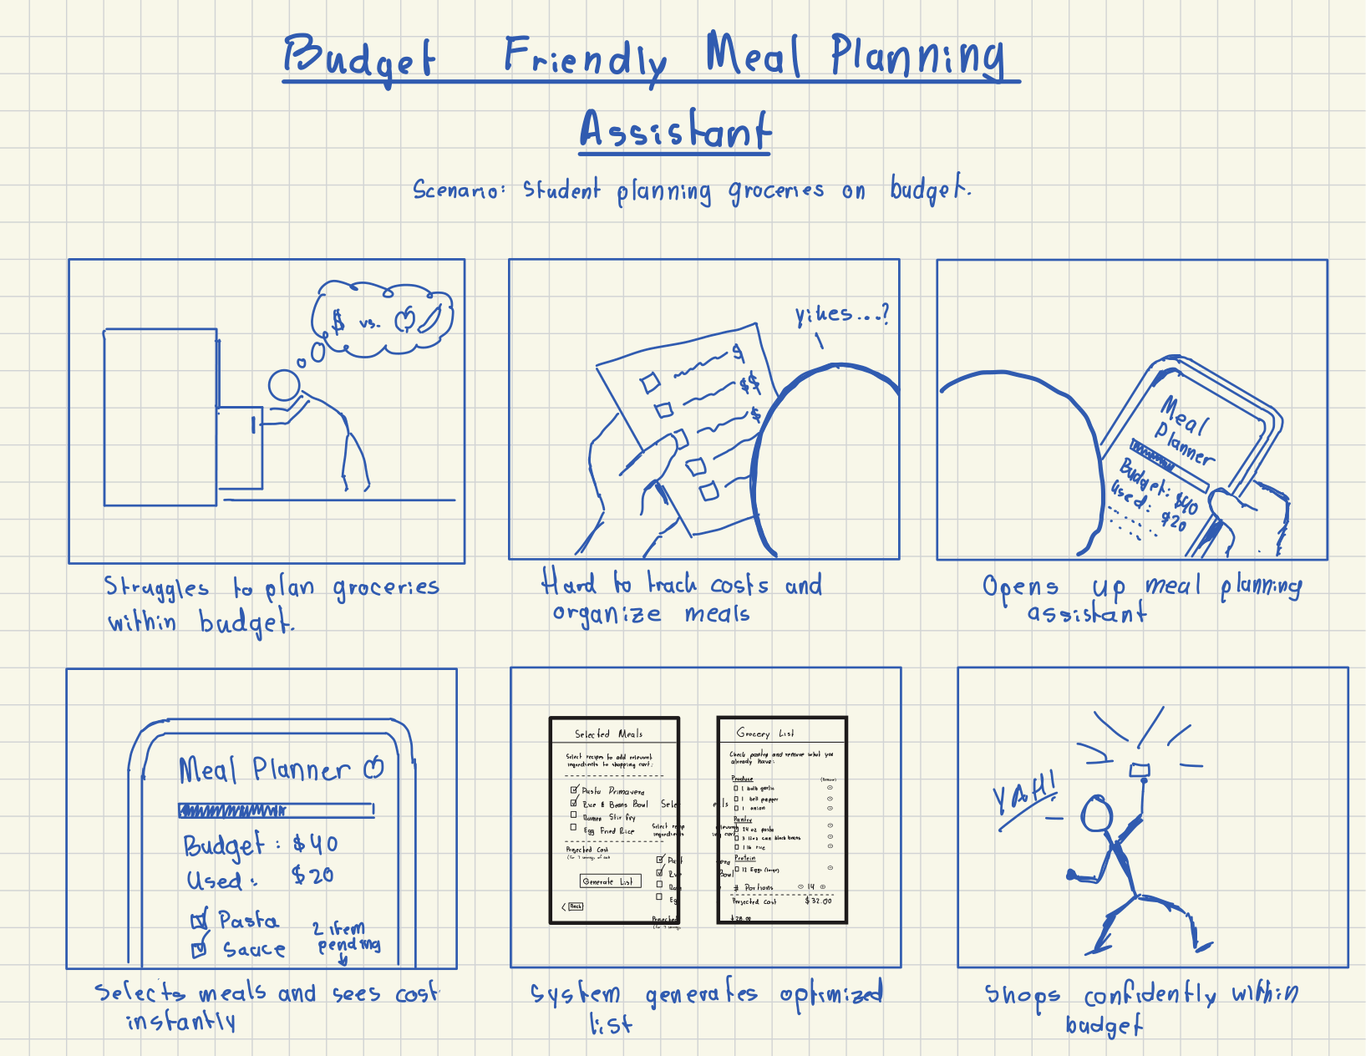
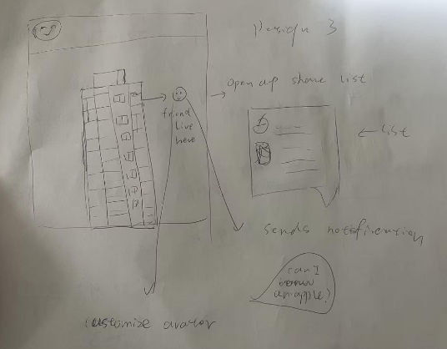
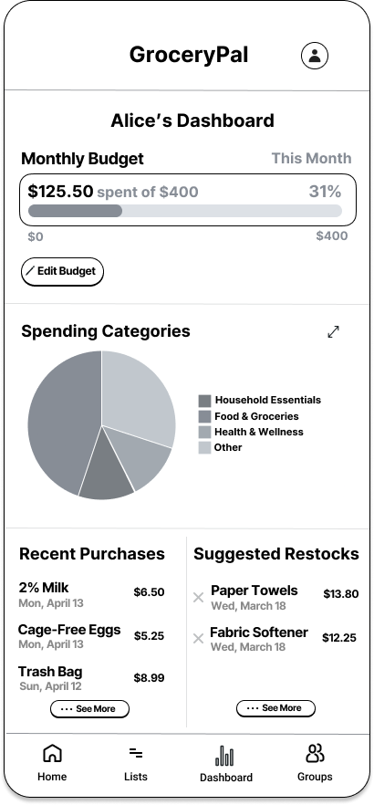
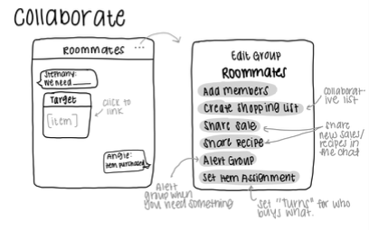
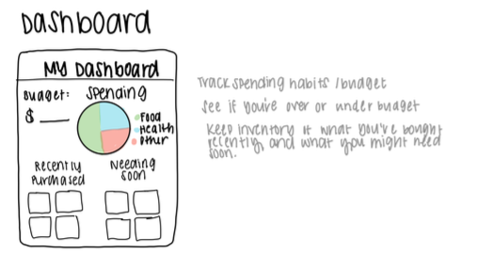
Design Evolution
Wireframes → Hi-Fi
Sketch + Critique
Locked in a four-item bottom nav: Home, Lists, Dashboard, Groups to reduce cognitive load. Visual hierarchy and accent color signal in-budget status.
Concept sketches converged into one. Each addressed part of the cognitive-load problem.
User testing showed the meal-selection flow worked, but the generate-list step caused hesitation.
Storyboard + Paper Proto
Notes:
Alejandro (~65 sec): The integrated design went through many stages. We started with hand-drawn sketches that put meal planning, price comparison, and budget tracking onto a single screen — that consolidation directly attacked the cognitive-load problem we’d identified. From there, we built storyboards and a low-fidelity paper prototype, which we tested with one student. The test showed that the meal-selection flow worked but the generate-list step caused hesitation — both findings carried forward. In the wireframes we locked in a four-item bottom navigation — Home, Lists, Dashboard, Groups — using the information-architecture principles from class: consistent labels, predictable hierarchy, and the same nav grid on every screen so users don’t have to relearn the interface. In the hi-fi mockup we applied visual-design principles directly: contrast pulls the eye to the budget bar and the savings call-out, list patterns stay consistent across screens, and a single accent color signals positive financial outcomes — savings and in-budget status.

Slide 7
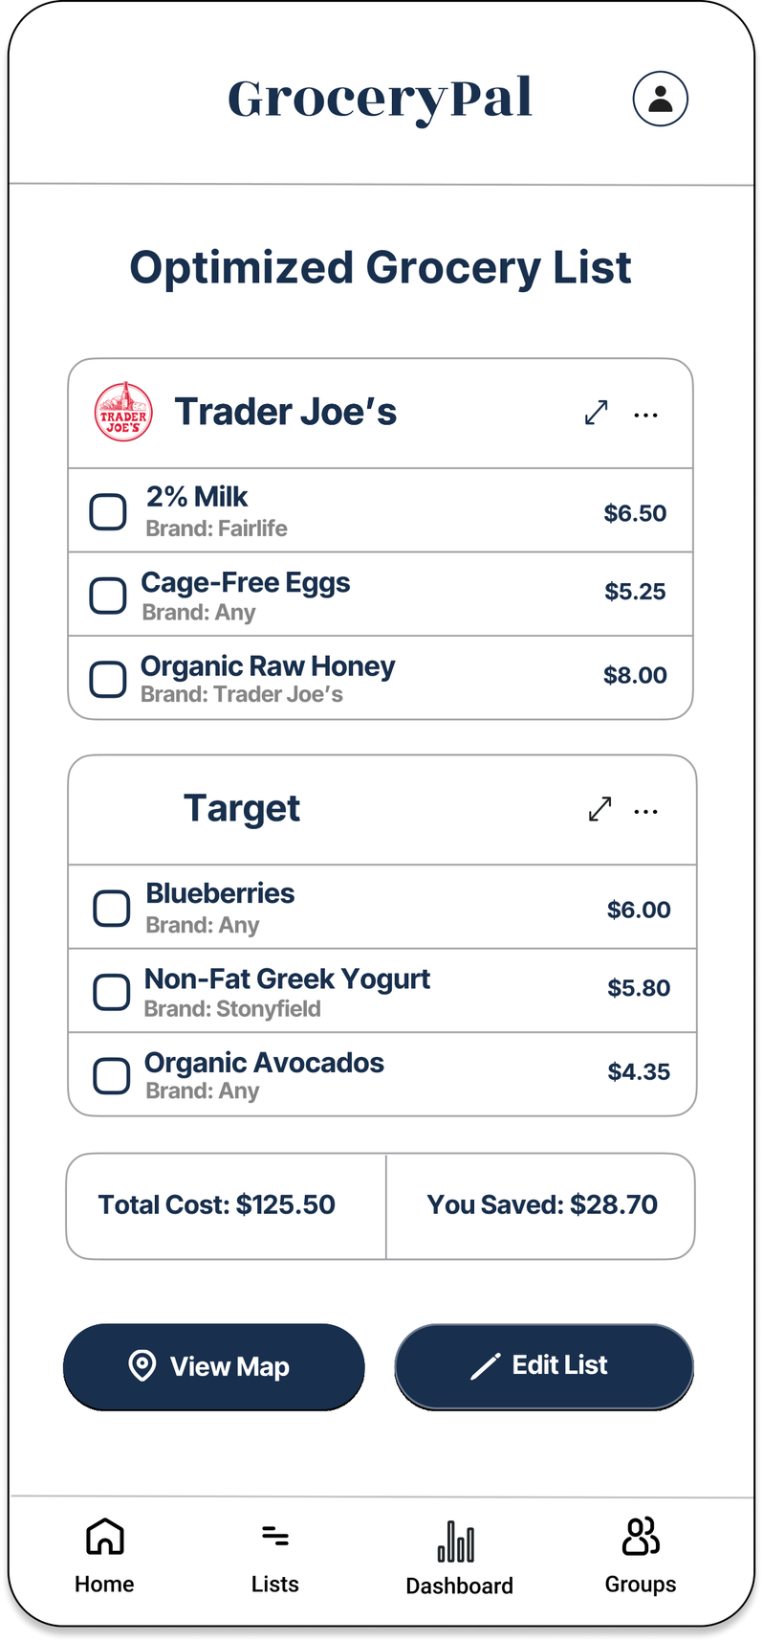
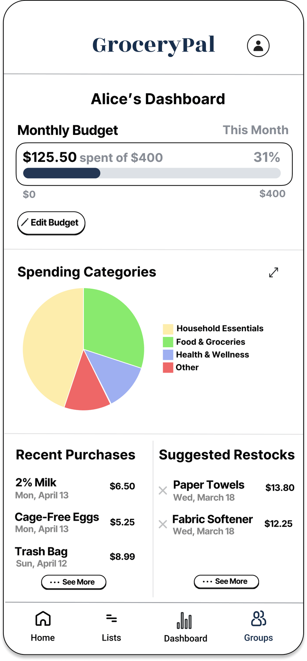
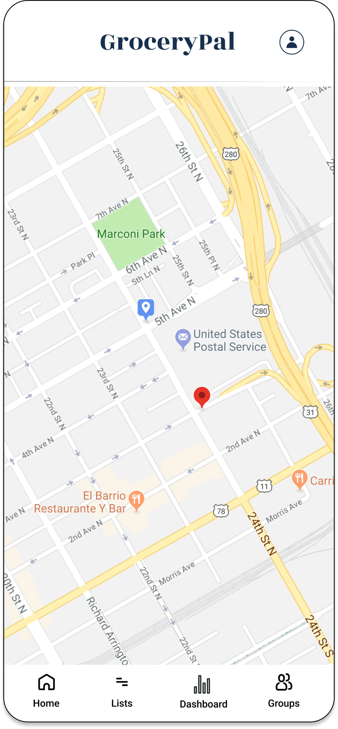
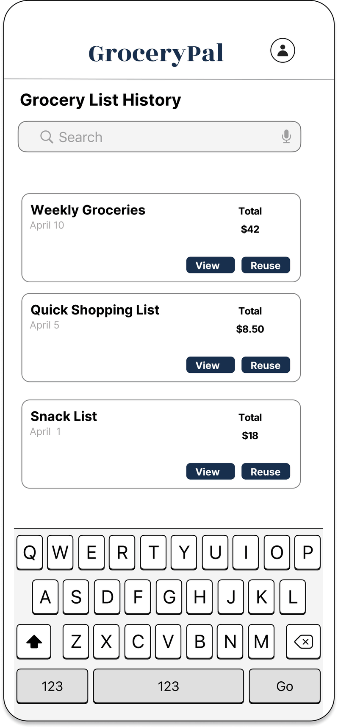
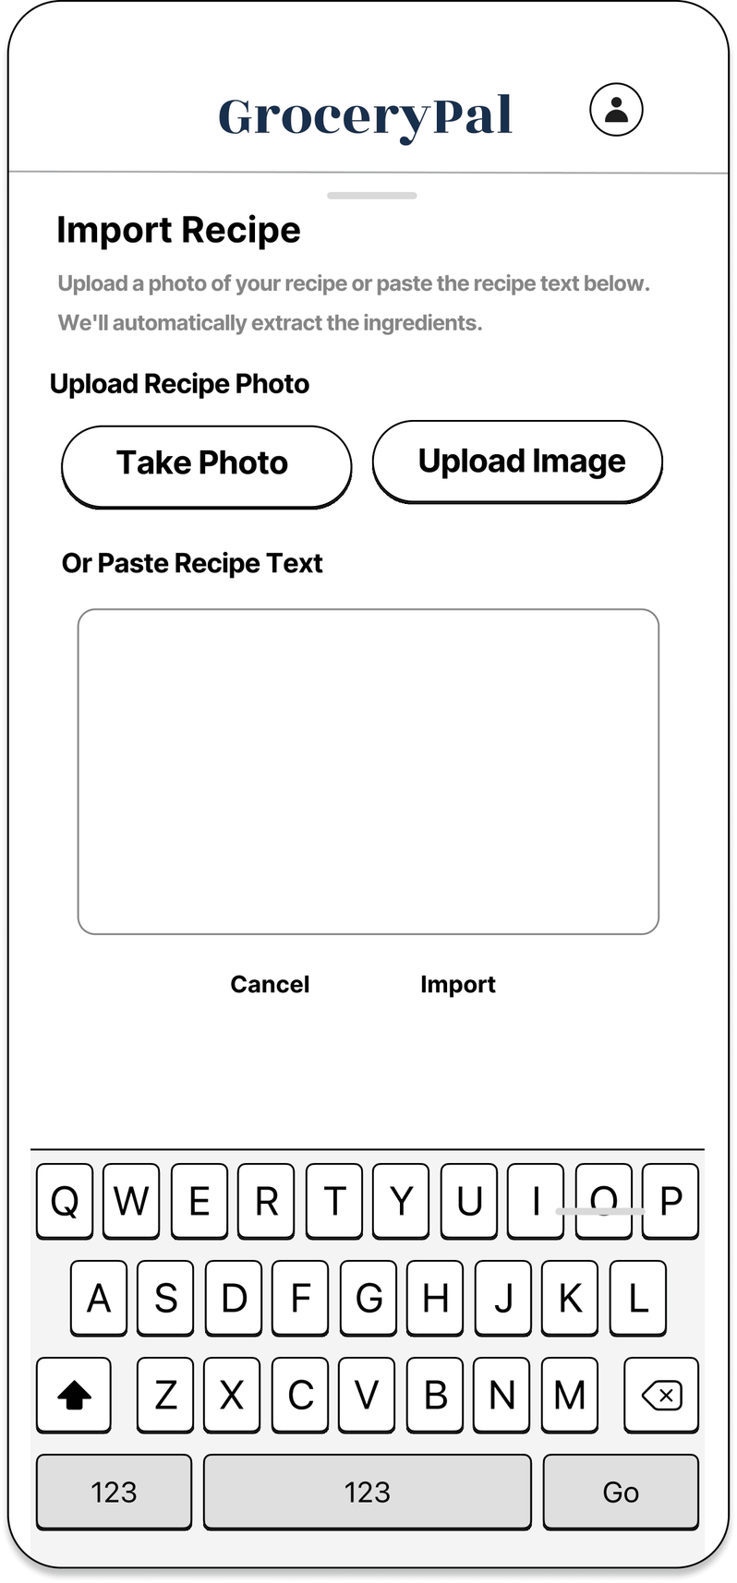
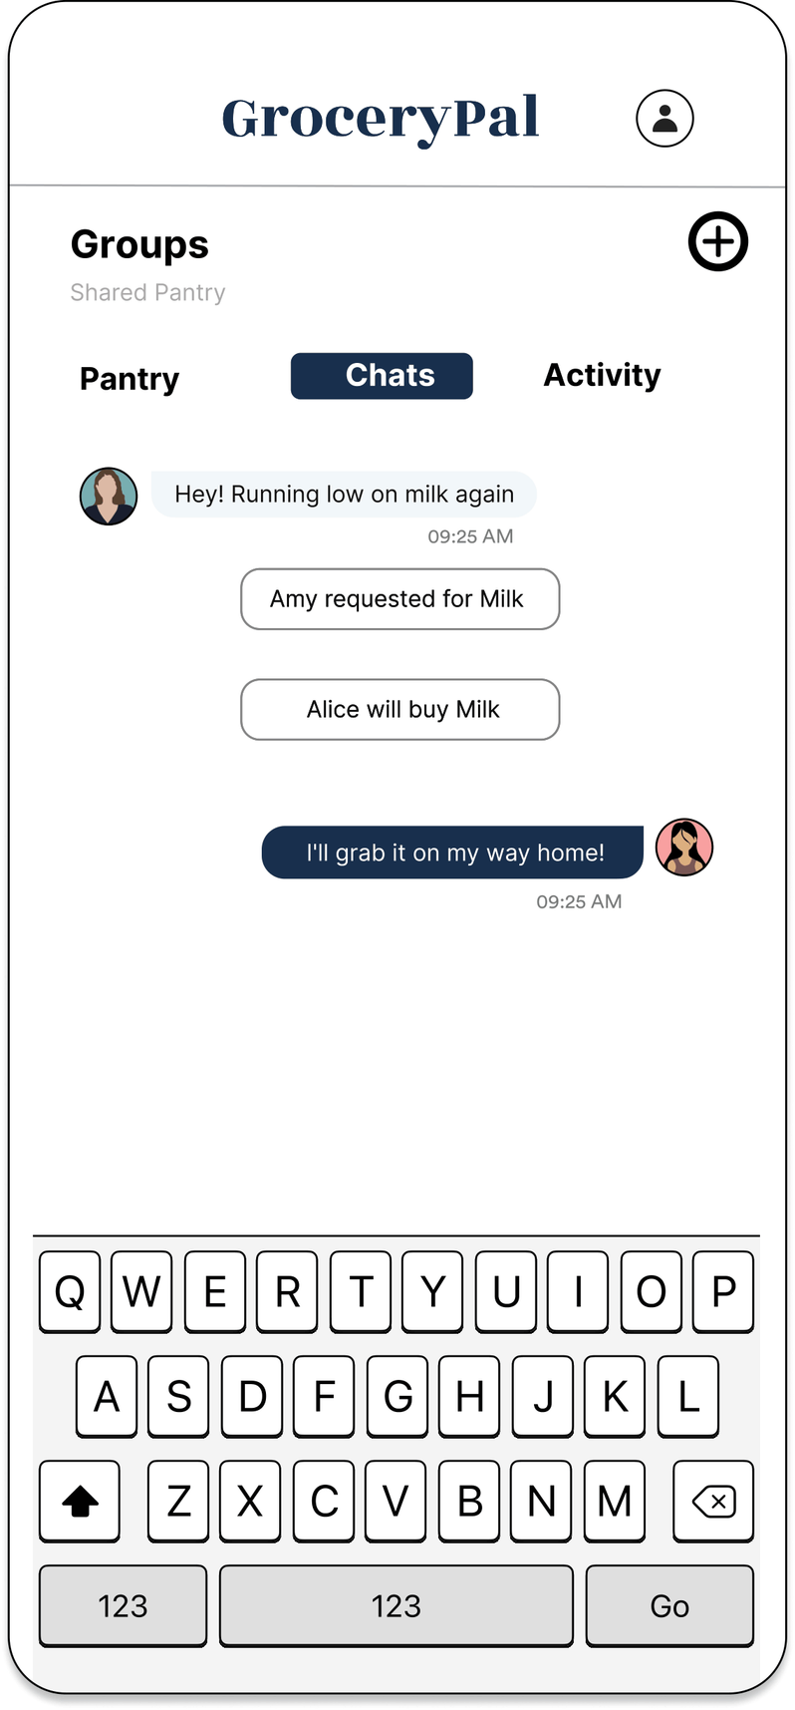
Features
Grocery List
Budget Tracking
Store Navigation
Build, store, and reuse weekly lists — auto-grouped by store.
Full grocery total visible against the monthly budget at every step.
Multi-stop route across the cheapest store split — no manual comparison.
Meal Planning
Recipe Integration
Roommate Coordination
Plan meals from a budget; recipes auto-generate the grocery list.
Paste any recipe; ingredients land in the optimized list.
Communicate with roommate within the app to avoid double-buying
Notes:
Helena (~50 sec): Here’s where we landed. GroceryPal pulls everything we identified into one app: a grocery list that auto-groups items by store, a budget dashboard that keeps the full total visible against your monthly budget at every step, a multi-stop route that hands you the cheapest store split with no manual comparison, a meal planner that builds the grocery list from your weekly plan, recipe import that drops ingredients straight into the optimized list, and roommate coordination that prevents the double-buys and miscommunication we saw in the field. This solves the problem directly: GroceryPal absorbs the comparison, routing, coordination, and budgeting work students were already doing in their heads — they get the financial benefit without the cognitive cost.

Slide 8

Figma Prototype
Notes:
Helena:
And here’s our interactive prototype — scan the QR code or click the link, and you can complete the demo task: import a recipe and finish an optimized two-store trip while staying inside your monthly budget. *[handoff to Angelique]*
Angelique (~35 sec):
With more time, three next steps. First, usability testing with SNAP-eligible students and students who rely on transit, so the routing feature reflects real constraints — not just optimal pricing. Second, pantry-aware recommendations so the app remembers what you already have at home. And third, integrating a real-time price API so the comparisons stay accurate. Thanks for listening.

